Slide 1
Chapter 1 Why is injury prevention in sports important?

Slide 2
Is injury prevention important?
Epidemiological studies show:
Every sixth is sustained during sporting activity (Bahr et al., 2002)
Among children, every third hospital-treated injury result of sports participation (Bahr et al., 2002)
3.7 million sports- and recreation-related emergency department visits (Junge et al., 2006)
A soccer and handball player suffered one injury every 10th match, a volleyball player at the elite level only had an injury every 100th match on the average. (Drawer & Fuller, 2002)

Slide 3
Injury rate is reported as the number of injuries per 1000 player matches (95% CI) Junge et al. (2006).
Sport | Total injury rate | Rate of time-loss injuries
Football | 109 (85–133) | 44 (29–60)
Handball | 89 (64–114) | 40 (23–57)
Basketball | 64 (40–89) | 29 (12–45)
Field hockey | 55 (37–72) | 24 (12–36)
Baseball | 29 (15–43) | 13 (3.2–22)
Water polo | 30 (16–44) | 9 (1.1–16.3)
Volleyball | 11 (1.4–21) | 9 (0.2–17)

Slide 4
Is injury prevention important?
Incidence of concussion 0.5 injuries per 1000 match hours
Among injuries related to football, 4–22% are head injuries
Incidence during matches 1.7 injuries per 1000 player hours (Andersen et al., 2004)
The highest incidence of anterior cruciate ligament injuries: in 15-25-year-old athletes (in pivoting sports: football, basketball and handball.
Incidence: 3-5 times women > men (Griffin et al., 2006)

Slide 5
Is injury prevention important?
Lack evidence to suggest that reconstructive surgery of either menisci or cruciate ligaments decrease the rate of post-traumatic osteoarthritis.
After 10 years, approximately half of the patients display signs of OA
Patients will have osteoarthrosis after 15–20 years (Myklebust & Bahr, 2005)

Slide 6
Is there an evidence base for injury prevention?
In May 2000, a PubMed search revealed that out of 10,691 papers on athletic injury, there were only six randomized controlled trials (RCTs) on sports injury prevention
Reduction in the risk of head injury with helmet use (Hagel et al., 2005; Sulheim et al., 2006)
Injury prevention program indicating a reduced frequency of spinal cord injuries in rugby (Quarrie et al., 2007).

Slide 7
Is sports participation healthy?
Regular physical activity reduces the risk of premature mortality in general, and of coronary heart disease, hypertension, colon cancer, obesity, and diabetes mellitus
The overall life expectancy was higher in the high-level athlete compared to a matched reference group (75.6 vs. 69.9 years).
The rate of hospitalization < endurance sports and power sports compared to the reference group (Kujala et al., 1996).

Slide 8
Is sports participation healthy?
A follow-up study: team sport athletes had a higher risk of knee OA, and other studies have documented an increased risk of hip and knee arthritis among former football players.
The evidence suggests that although sports participation is beneficial, injuries have significant side effects.
To promote physical activity effectively, we have to deal professionally with the health problems of the active patient. This does not only involve providing effective care for the injured patient, but also developing and promoting injury prevention measures actively

Slide 9
The future of injury prevention
Information about risk factors and their relative roles
If the relative additional risk of having specific risk factors is known, some individuals should probably be advised against participation in certain sports where the risk factor cannot be eliminated.
If the effect of eliminating one risk factor after another is known, individuals may be able to participate in sports with low risk if they are compliant with their specific training program.
The goal must be to reach a stage where the risk factors are known and assign a relative risk of an injury to individuals.
During the preseason examination, individuals with risk factors can then be assigned training programs that have been validated.

Slide 10
Chapter 2
A systematic approach to sports injury prevention

Slide 11
Benefits of injury prevention
Greater health of the individual
Longevity in the activity
Reduced costs to the individual, the sport, the health care system, and society.
An obvious benefit: the potential for better performance

Slide 12
Prevention categories
Primary: avoidance of injury (e.g., ankle braces being worn by an entire team, even those with no history of previous ankle sprains)
Secondary: early diagnosis and treatment once an injury has occurred (e.g., early RICE treatment of an ankle sprain)
Tertiary: focus on rehabilitation to reduce/correct an existing disability attributed to an underlying disease; what most people think of as rehabilitation (e.g., a patient with an ankle sprain, this would involve balance board exercises and wearing an ankle brace while gradually returning to sport)

Slide 13
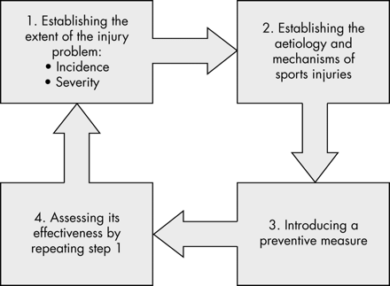
Sequence of injury prevention research

Slide 14
Injury surveillance
The object of surveillance is to enumerate the extent of injury in a given group or population
Which injury types should be targeted when considering injury prevention in different sports
Surveillance within a specific team, league, or sport organization can also highlight potential areas of prevention that might be unique to that group (A soccer coach focus on hamstring strains, knee and ankle sprains, whereas a baseball coach may decide to consider shoulder and elbow problems)
Concerns: injury rate, injury severity

Slide 15
Injury definition
A consensus statement in 2006 football (soccer) stating that the broadest definition of injury would be any event occurring as a result of participation in sport (Fuller et al., 2006).
Injury was then further classified into medical attention injuries; those that required assessment or treatment by a medical practitioner. A further sub-division was time loss injuries; those causing a player to miss one or more practices or games or sessions.
This is important to ensure consistency both within a given period of surveillance and over time between different periods of surveillanc

Slide 16
Injury classification
Classification of injury into various body regions and injury types (Fuller et al., 2006)
Coding system (The Orchard Sports Injury Classification System)

Slide 17
Injury severity
The “time lost” can be counted in days or sessions (games or practices) missed
Severity was defined as; minimal (1–3 days), mild (4–7 days), moderate (8-28 days) and severe (>28 days)

Slide 18
Injury recurrence
Recurrence be grouped into “exacerbations” and “reinjuries.
Exacerbations should not be counted as a new injury event, but any time missed should be attributed to the first injury.
Reinjuries should be counted as a separate injury event with their own time loss

Slide 19
Exposure
Participation can be counted in hours or sessions.
From exposure, an injury rate/incidence rate, can be calculated.
Injury incidence is typically reported as the number of injuries per 1000 hours of player exposure.
This allows injury risk to be compared between different sports and different groups.

Slide 20
Determining the causes of injury-Risk factors
They are considered risk factors if they increase the chance of an injury occurring
There are internal or intrinsic risk factors and external or extrinsic factors

Slide 21
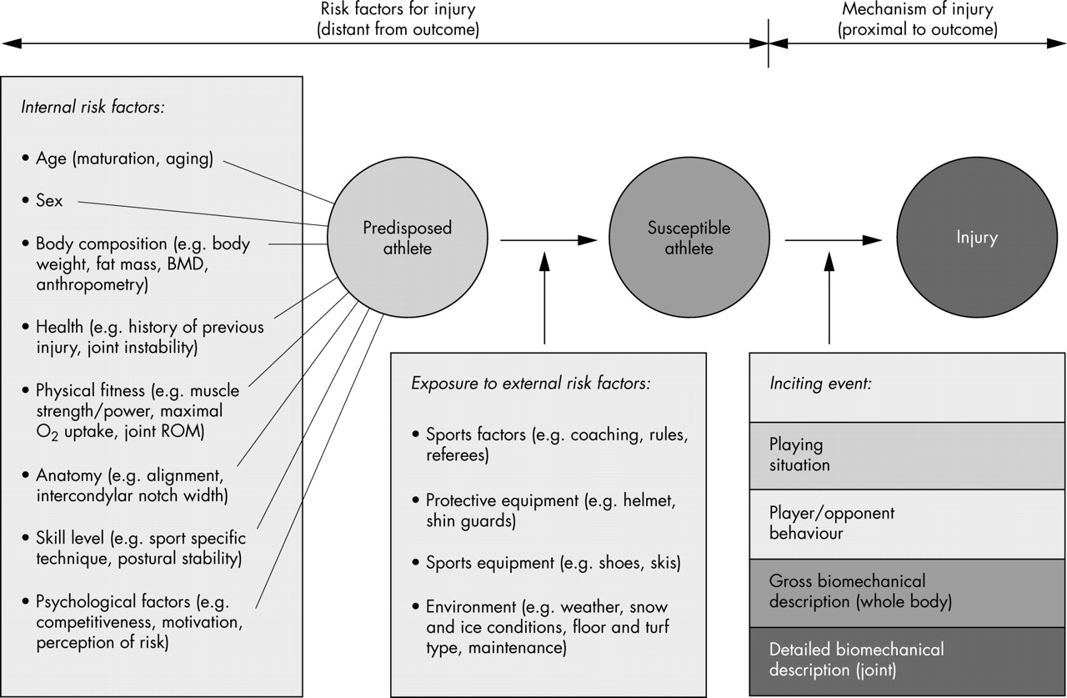
Determining the causes of injury-ethiology

Slide 22
Modiﬁable and non-modiﬁable risk factors
The best way to prevent injury is to change the risk factor
For example:
A risk factor of muscle weakness can be overcome with a strengthening program,
A risk factor of poor proprioception can be improved by balance re-training.
If artiﬁcial turf were a risk factor, it could be minimized by playing on grass
The risk factor cannot be changed
For example:
Gender: ACL injuries 4-6 times more common among female athletes than male athletes in soccer, basketball, and handball.

Slide 23
The mechanism of injury
The key to injury prevention may lie with the injury mechanisms, not with the risk factors
Injury mechanism: Contact, Non-contact
For example:
random event: struck in the face which could occur regardless of intrinsic or extrinsic risk factors. If defenders and attackers are hit as often as goalies, it may not be possible to identify the player at risk
It may be important to have detailed knowledge of the biomechanics
For example:
to design an appropriate hockey helmet, it is necessary to have an accurate estimate of the impact forces involved in the game, such as when a falling player hits the ice.

Slide 24
The mechanism of injury
The key to injury prevention may lie with the events leading to the injury situation (playing situation, player, and opponent behaviour)
For example:
to prevent head injuries in soccer the ﬁrst question is: What strikes the head? The ball? Or is it a head to-head clash with an opponent in a heading duel? Or the opponent’s arm or elbow? Or do head injuries typically result when falling and hitting the ground?
…..Strict rule for elbow use

Slide 25
Developing intervention methods and programs The third stage (van Mechelen’s approach) is the introduction of prevention measures
 | Pre-crash | Crash | Post-crash
Athlete | Technique, Neuromuscular function | Training status (strength, flexibility), falling techniques | Rehabilitation
Surroundings | Floor friction, playing rules | Safety nets, soft mats | Emergency medical coverage
Equipment | Shoe friction | Tape or brace, leg padding | First aid, equipment ambulance

Slide 26
Active versus passive measures
Injury prevention measures can be categorized as:
Active :
Motor vehicle accident prevention are seat belts (active) which require the individual to fasten them
The type of facial protection in ice hockey is optional
Passive
Air bags (passive) which do not require the operator to take any action.

Slide 27
Implementing injury prevention programs
There is a need to carefully develop the prevention measures, assess them under ideal conditions, and consider the implementation context.
An important part of the development of interventions is ﬁrst testing their efﬁcacy. This means that under ideal conditions, they are tested to determine if the intervention works. This differs from effectiveness, which is where an intervention is implemented in a broader context, often in a community or sport setting, where the degree of attention to the program and monitoring is much less
If a prevention program is biologically appropriate, but not appropriate within the context of the sport, it has little hope of being adopted. Facial protection in adolescence ice hockey could lead to an increase in neck injuries.

Slide 28
Chapter 3
Developing and managing an injury prevention program within the team

Slide 29
Team of risk management
Support team, manager, coach, trainer, physiotherapist, and doctor.
Communication and coordination within the support team and between and the athletes is necessary

Slide 30
Principles of risk management
Risk management is the overall process of identifying, assessing, and controlling risks
Identifying: e.g. participants in contact sports experience head injuries.
Risk assessment: is process of measurement and estimation of hazard (incidence, severity, risk factors, mechanisms
Risk control: is the process of implementing methods to control the level of exposure to hazards and the consequences.
Four options for risk control: eliminate, retain and manage, outsource, and insure. ( In sport)

Slide 31
Principles of risk management
Elimination of the sporting activity is not an option, although under some circumstances a team may decide not to participate
E.g. war, terrorism, weather
A sports team could not be outsourced
E.g. A cleaning function in a company could be outsourced to contractors.

Slide 32
Principles of risk management
The two choices that are most often faced :
To accept a risk:
Insurance will cover their loss in case of injury
Employing extra players
Reduce a risk
Involves developing and applying methods to prevent injuries and/or reduce their consequences

Slide 33
Risk identiﬁcation and assessment
Having good on- and off-ﬁeld medical treatment and rehabilitation is not injury risk management
The basic steps:
• Reviewing injury reports from at least one season;
• Reviewing player turnover and availability within one or more seasons;
• Reviewing the literature on injury risks in the speciﬁc sport.
Surveillance System: (Hockey, Skiing)
the goal: to reduce injury rates through suggested changes in rules, protective equipment, or coaching techniques based on data provided.

Slide 34
Risk control: injury prevention
Hierarchy of controls
Example: Skiing
Elimination
Training
Personal protective equipment
Engineering controls
Substitution
Administrative controls

Slide 35
Reaching agreement
Agreement on injury prevention within the team, between teams
Objectives need to be realistic, important, and common from the players to the ofﬁcials
The following discussion will focus on two areas:
First, focusing on the potential roles of medical staff
Second, discussing the importance of equipment and facilities in injury prevention.

Slide 36
The roles of the medical staff
Team medical staff : physicians, physiotherapists, athletic trainers, etc
Recording of injury - develop an injury surveillance program;
Season analysis- review of training and competition program;
Preseason screening of physical and behavioural capabilities
Monitoring “at risk” team members, for example ﬁtness, technique, and behaviour;
Education regarding injury management and prevention;
Identiﬁcation of emergency management requirements;
Coordination of injury risk management;

Slide 37
The roles of the medical staff- 1. Developing an injury surveillance program
Establish a system to monitor injuries and exposure.
Recording injuries. (electronic tools )
Exposure data are collected. E.g. there is an increase in the number of match injuries from one season to the next. If the number of matches increases by 30%, there would be no increase in injury incidence.
The severity of injury must also be taken into account (expressed as the number of days of absence from sports because of an injury)
Injury priorities
Monitor injury mechanisms using match tapes

Slide 38
The roles of the medical staff- 2. Season analysis: review of training and competition
Season analysis represents an attempt to identify risks before they occur
1. Change of surface, climate, and running.
2. Transition to higher training volume and high intensity of training
3. New training camp before the competitive season
4. The beginning of the competitive season. (A higher tempo, Change of surface to soft grass)
5. High risk of acute injuries during the competition season
6. Interposed period of hard basic training, strength exercises to which the athlete is not accustomed
7. The end of the competitive season and tired players
8. Transition to basic training period with running on gravel.

Slide 39
The roles of the medical staff- 3.Preseason screening: pre-participation/annual examination
The general screening examination such as:
• Musculoskeletal injuries (marphan syndrom)
• Cardiovascular disease and risk
• Asthma and pulmonary function
• Eating disorders
• Cognitive deﬁcits related to mild traumatic brain injury.

Slide 40
The roles of the medical staff- 3.Preseason screening: pre-participation/annual examination
For screening exams to serve a purpose in risk management there are some additional requirements:
First, the exam must be designed to identify athletes with risk factors relevant to the sport (select appropriate methods with high sensitivity)
Second, there must be a plan to follow up athletes with measures intended to reduce risk, if risk factors are identified. (if strength is inadequate, it should be followed up with a strength training program)
Third, the screening exam and follow-up must be planned and led by the medical and coaching staff of the team. (the specialist must be up to date with screening methods)

Slide 41
The roles of the medical staff- 4.Monitoring “at risk” team members (ﬁtness, technique, behaviour)
The screening of all players preseason may ﬂow into within season
Has a player recovered physical capacity following a medical condition?
Is there improvement in a player’s technique following identiﬁcation of a deﬁcit in a training program?
If the preseason screening identiﬁed a player with a history of inappropriate on/off-ﬁeld behaviour, have appropriate steps been taken and are there changes?
Is the athlete attending rehabilitation sessions?
Is the athlete wearing the speciﬁc item of protective clothing correctly?

Slide 42
The roles of the medical staff- 4.Monitoring “at risk” team members (ﬁtness, technique, behaviour)
Return to play following injury:
A player will clearly perform to their best and over a longer time (seasons) if injuries are managed well
An injured player was not eligible for first team selection until he had been able to participate fully in team training without pain and swelling at the injured body site.
The required number of pre match training sessions varied based on the severity of the injury.
Coaches should instructed to evaluate symptoms

Slide 43
The roles of the medical staff- 5.Education regarding injury management and prevention
This will at least raise awareness of specific topics, such as symptoms that might be related to concussion
Specific sessions can be conducted preseason and within season.
A preseason session provides an opportunity to:
Present a summary of the findings from the previous season’s injury surveillance program
Permit discussion on injury management and prevention (The rules may have been changed or substantial changes made in equipment and facilities)
During the season, opportunities arise in team meetings to present updates and reminders on relevant topics.

Slide 44
The roles of the medical staff- 6.Identiﬁcation of emergency management requirements
Emergency management is an integral part of risk management.
Emergency management cannot prevent the initial injury, but it can prevent subsequent injury and reduce the level of impairment.
The first step is to identify the team’s requirements.
Injury surveillance and risk assessments will identify the nature and extent of the emergency management responses required (spinal injury, head injury, heat stress…)
In all contact sports risk of head and spinal injury is sufficient to warrant making emergency equipment easily available

Slide 45
The roles of the medical staff- 7.Coordination of injury risk management
1. Assessing the team’s needs
2. Setting goals and objectives
3. Development of policies, strategies, programs and actions aimed at achieving goals
4. Implementing programs and policies, including education
5. Providing resources to implement programs
6. Establishing a system for review and evaluation

Slide 46
Equipment and facilities- International and national standards for equipment and facilities
There are standards for:
Helmets
Playing surfaces
Shin guards
Gymnastics mat
The International Gymnastics Federation (FIG) provides guidelines regarding size and stiffness of crash mats and equipment design
Surprisingly, standards do not exist for some equipment. There is no standard for padding for goal posts

Slide 47
Equipment and facilities- Behavioural adaptation
Athletes should be informed and educated about the injury risks in sport and the known effectiveness and limitations of protective equipment and other controls

Slide 48
Equipment and facilities- Maintenance of facilities and equipment
All members of the broad team are responsible for the equipment and facilities. Certainly it is not possible for a player to re-surface an area, but the player might alert team management to those concerns. Damage or wear and tear might create hazards for players and ofﬁcials.
A protocol for routine inspection of facilities and equipment should be a part of a risk management plan.

Slide 49
Equipment and facilities- Training
It is important that teams are trained to use equipment. (advising on the level of protection offered by particular equipment, the correct use, adjustment and care of equipment, and equipment misuse)
Training drills while wearing equipment are important

Slide 50
Chapter 4 Preventing ankle injuries

Slide 51
Epidemiology of ankle injuries in sport
Across all sports the most common location of injury is the ankle (25% of all injuries)
Ankle injuries can be classified:
Acute: ligament injuries (85% of all ankle injuries: lateral ankle ligaments)
Chronic: sequelae of acute sprains/overuse syndromes of the surrounding soft tissues.
Lateral ankle Ligaments protect the ankle joint from abnormal movements (excessive twisting, turning, and rolling of the foot)
A side effect of an ankle sprain is the high risk of re-injury to the same ankle, (result in disability and can lead to chronic pain or instability in 20–50% of these recurrent cases)

Slide 52
Key risk factors: how to identify athletes at risk Previous ankle ligament sprain
The most important risk factor is previous sprain
Disruption of a ligament compromises an important biomechanical stabilizer of the ankle that can compromise neuromuscular control of the ankle (Hertel, 2000).
Studies of soccer, volleyball, basketball athletes, and military recruits found that they were all at a twofold risk for lateral ankle ligament injury after suffering a prior ankle injury

Slide 53
Key risk factors: how to identify athletes at risk Postural sway
Postural sway is closely linked to a previous ankle sprain occurrence (Willems et al., 2005a, b).
A sprain affects neuromuscular control of the ankle, subsequently leading to an increased risk of re-injury
Athlete’s center of gravity constantly changes position during upright posture and is under the control of both the central and the peripheral nervous system
Many different approaches have been used to characterize postural sway and this outcome appears to be related to the risk of suffering an ankle injury.

Slide 54
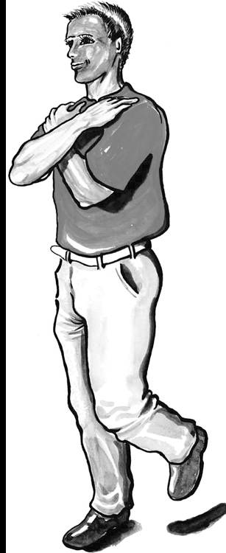
Key risk factors: how to identify athletes at risk Postural sway
Balance test. The patient stands on one leg
with the other leg slightly flexed and hanging straight down. He crosses his arms over his chest and looks at a point straight ahead. If he can balance for 1 min with his eyes open, he closes his eyes and balances for another 15 s is considered to have normal posture

Slide 55
Key risk factors: how to identify athletes at risk Gender
Female have a 25% higher risk than male basketball athletes considering the first time ankle ligament tear but repeated ankle ligament sprains in volleyball players is similar
Additional research that focuses on the effect of gender on the risk of suffering a first time ankle ligament injury is needed

Slide 56
Key risk factors: how to identify athletes at risk Range of motion of the ankle
A decrease in dorsiflexion range of motion of the ankle has been associated with an increased risk of suffering an ankle sprain (Willems et al., 2005a, b; de Noronha et al., 2006).
Tight gastrocnemius muscle–tendon complex, which could place the ankle–foot complex in greater plantar flexion during activity. This would place the ankle at an increased risk of abnormal inversion/internal rotation.
Participating in stretching programs that are designed to increase dorsiflexion motion.

Slide 57
Key risk factors: how to identify athletes at risk Height and weight
From soccer, American football reporting that athletes of greater height and weight and increased BMI are at increased ankle sprain risk
When a athlete is in an at risk position for inversion ankle trauma, an increase in either height or weight increases the magnitude of the inversion torque that must be resisted by the ligaments and muscles

Slide 58
Key risk factors: how to identify athletes at risk Limb dominance
Limb dominance has been implicated as a risk factor for lower extremity trauma because most athletes place a greater demand on their dominate limb and as a consequence produce an increased frequency and magnitude of moments about the knee and ankle, particularly during high demand activities that place the ankle and knee at risk

Slide 59
Key risk factors: how to identify athletes at risk Foot type, foot size, and anatomic alignment of the lower extremity
Anatomic foot type, when classified as pronated, supinated, or neutral, does not appear to be a risk factor for ankle sprains.
During an inversion injury, an increased foot width is associated with an increased moment arm and corresponding inversion moment in comparison to a narrow foot.

Slide 60
Key risk factors: how to identify athletes at risk Ankle joint laxity and generalized joint laxity
The literature presents conflicting findings with regard to the relationship between joint laxity and ankle ligament injury
The discrepancy between the available evidence:
May derive from the use of the clinical examination and a grading system to evaluate joint laxity. Indeed, accurate and reproducible clinical examination is not easy.
Another reason might be an inadequate sample size with too few subjects with increased ankle laxity included
It is important to appreciate that increased ankle joint laxity may be highly correlated with prior ankle ligament injury
There appears to be a consensus in the literature that generalized joint laxity has no predictive value for ankle sprains

Slide 61
Key risk factors: how to identify athletes at risk Muscle strength
There is little consensus between the studies.
An increased risk of ankle ligament injuries has been observed for female players (soccer, field hockey, and lacrosse)when they have higher peak torque ratios between the invertors and evertors of the ankle.
A study of male physical education students reported that decreased strength of the muscles that dorsiflexion the ankle was associated with an increased risk of suffering an ankle ligament injury (Willems et al., 2005b).
In contrast, a study of male military recruits found no relationship between muscle strength and the likelihood of suffering an ankle ligament injury

Slide 62
Key risk factors: how to identify athletes at risk Shoe type
Specific characteristics of the shoe may either:
Reduce the risk of injury (e.g., certain design characteristics may provide increased proprioceptive input)
Increase the risk of injury (e.g., restricted ankle range of motion)

Slide 63
Key risk factors: how to identify athletes at risk playing setting
There is a general consensus that across all sports the risk of injuries in general is higher during competition than during training:
During competition athletes are more prone to take “risks” in order to win
During training the playing environment is more controlled and thereby safer.

Slide 64
Key risk factors: how to identify athletes at risk Playing position
Volleyball athletes are at increased risk when they play the front row positions, by landing under the net after a jump for a spike or block.
Sports such as basketball and soccer which also involve jumping, planting, and cutting, the risk of ankle ligament injury appears to be similar between positions.
For soccer, it is known that most injuries occur when an athlete has to play outside his or her usual playing position

Slide 65
In overall

